Slide 1


Question Answering & Information Retrieval
UCREL Summer School. Session 2:
Dr Saad Ezzini and Damith Dola Mullage

Slide 2
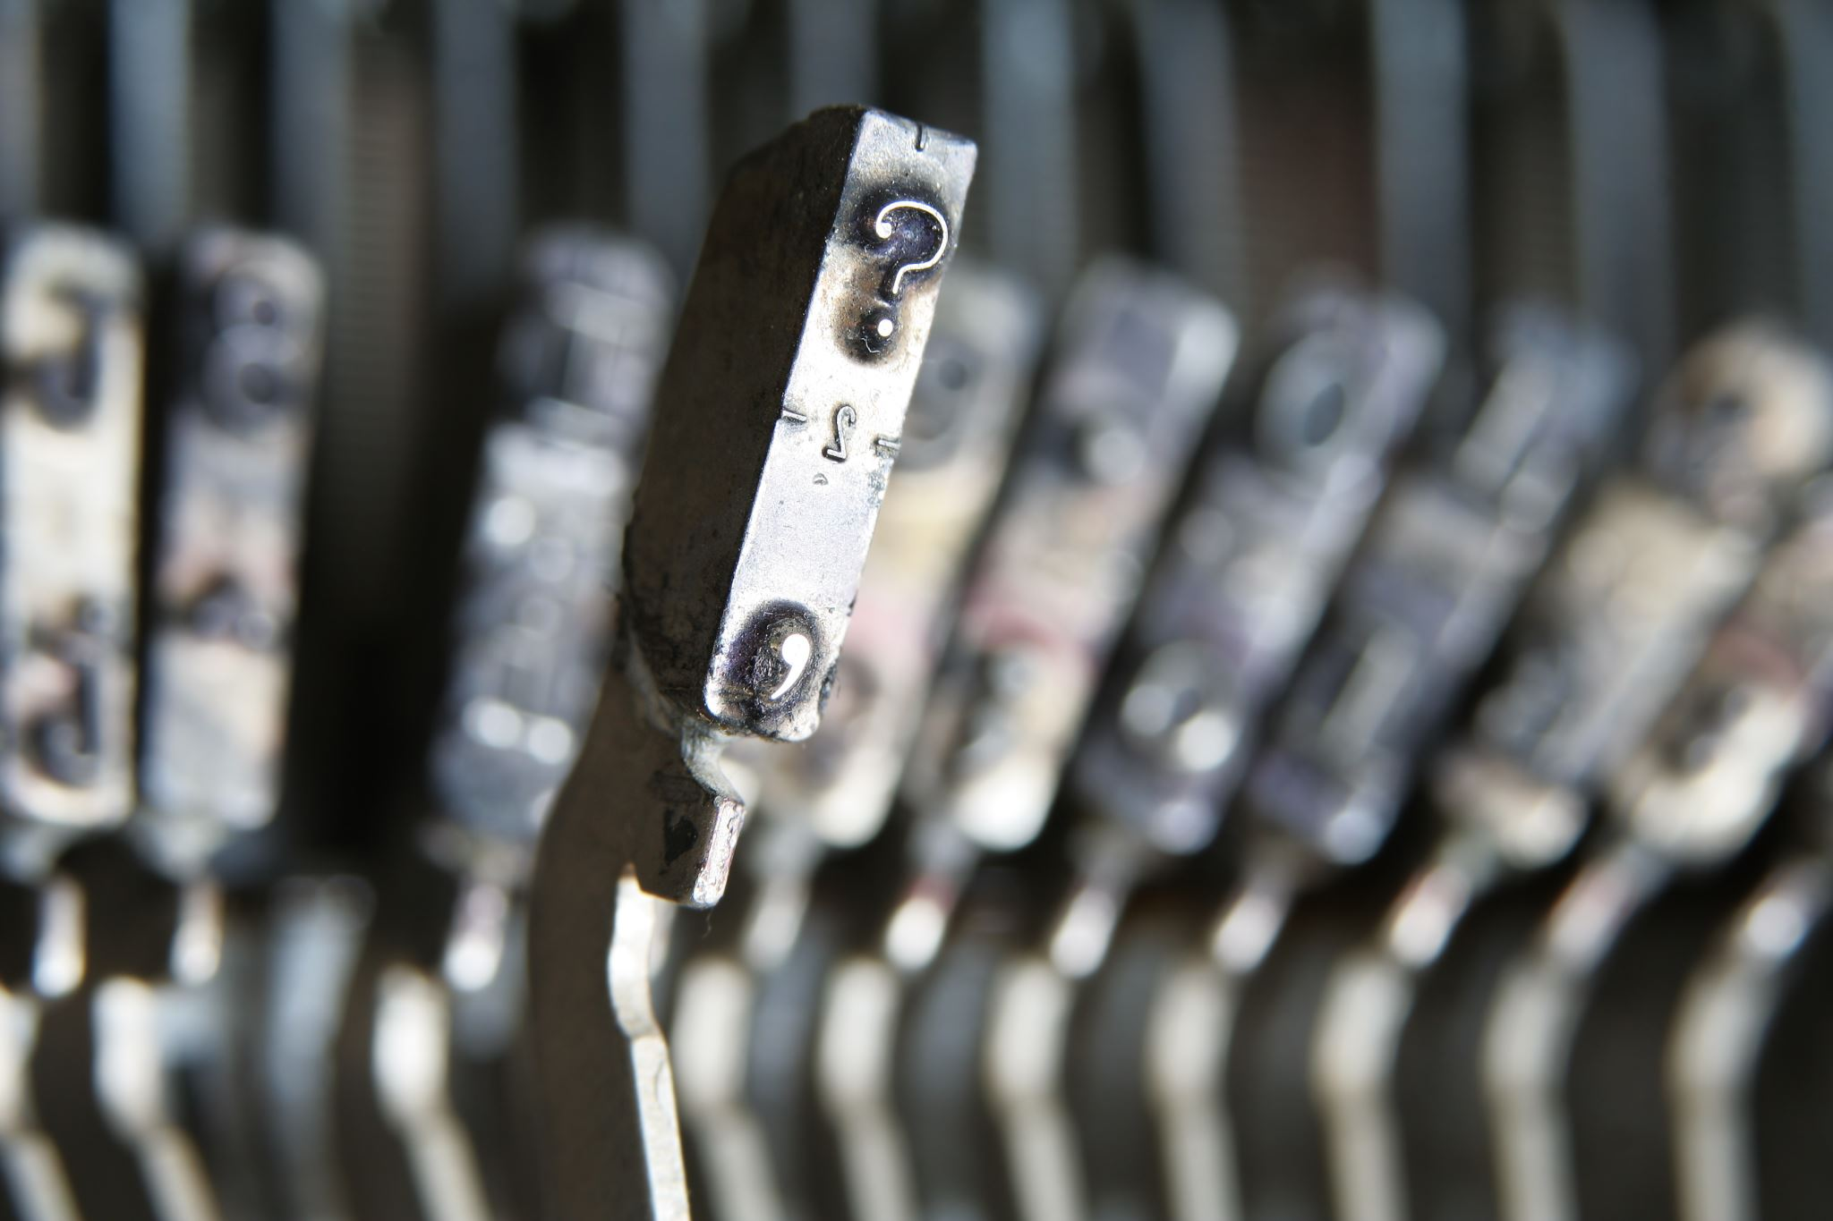
Agenda
Concept Presentation
Tutorial Walkthrough
Attendees Turn

Slide 3
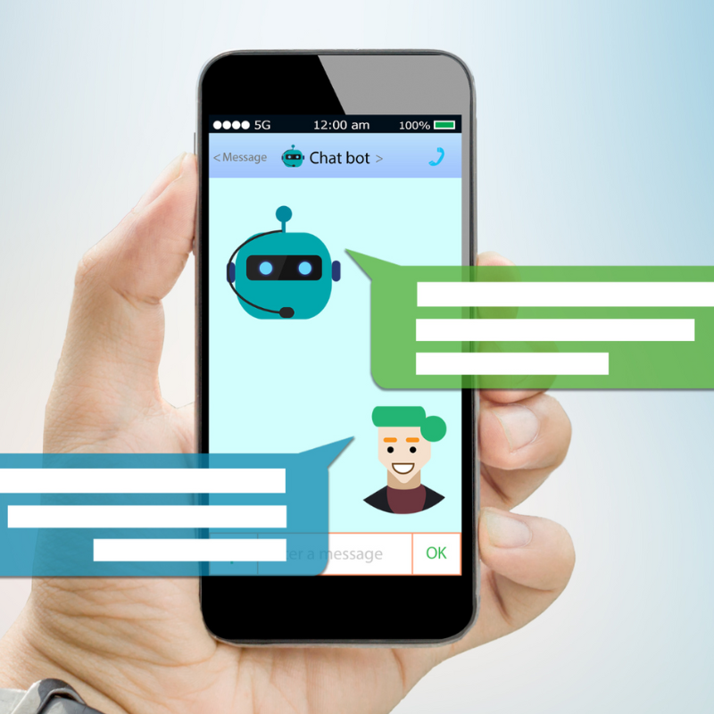
Introduction
ChatGPT
ChatBots
Banking
E-Commerce
This Photo by Unknown Author is licensed under CC BY-NC-ND

Slide 4
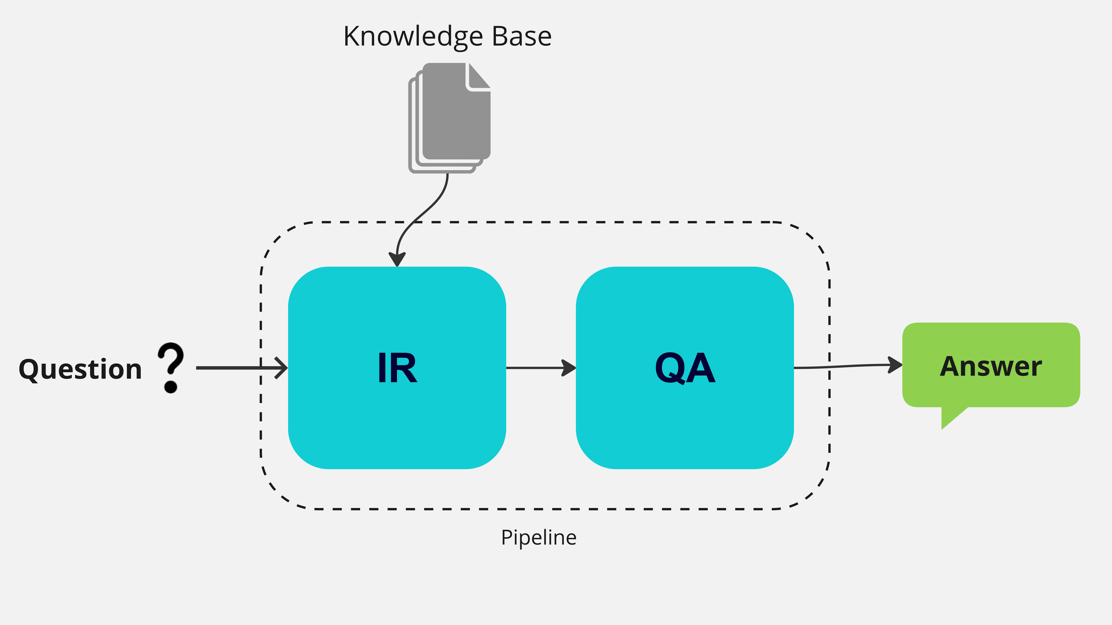
The Pipeline
Pipeline: a combination of multiple components with specific input and output
Input: a given question
Step1: IR retrieves the document that has the answer
Step2: QA uses the identified document to give the final answer.
IR: Information Retrieval
QA: Question Answering
Knowledge Base: external documents or sources that contain the answer (e.g., Wikipedia)

Slide 5
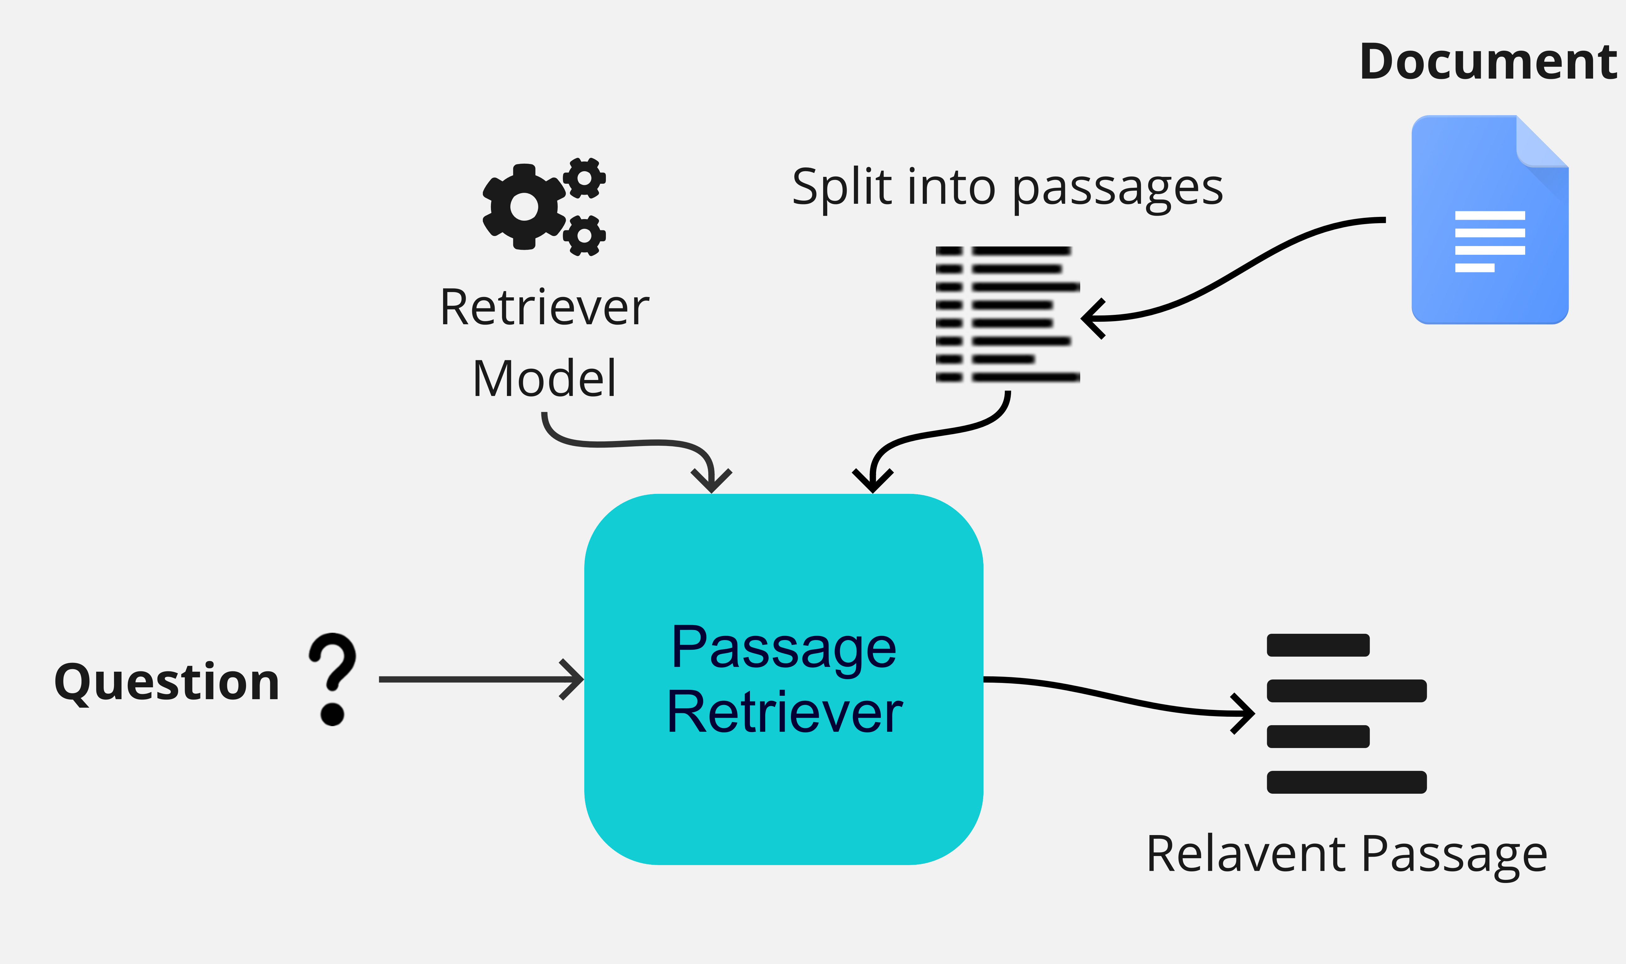
Context Retrieval (IR)

Slide 6
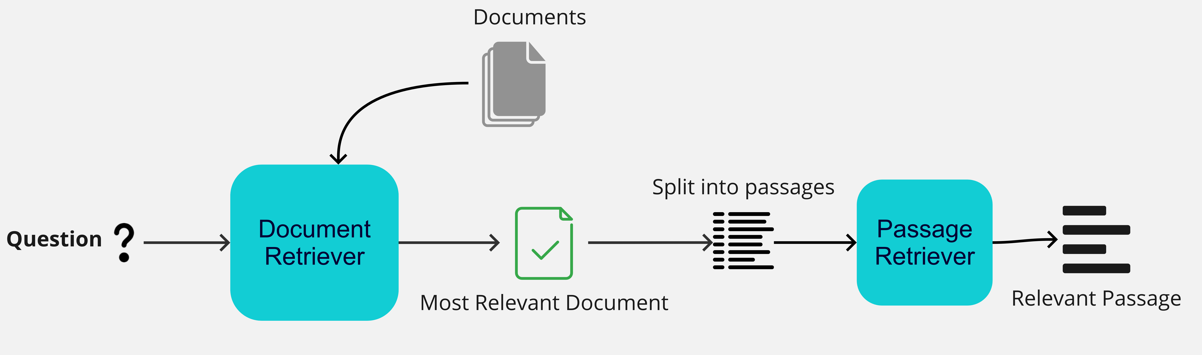
Double IR

Slide 7
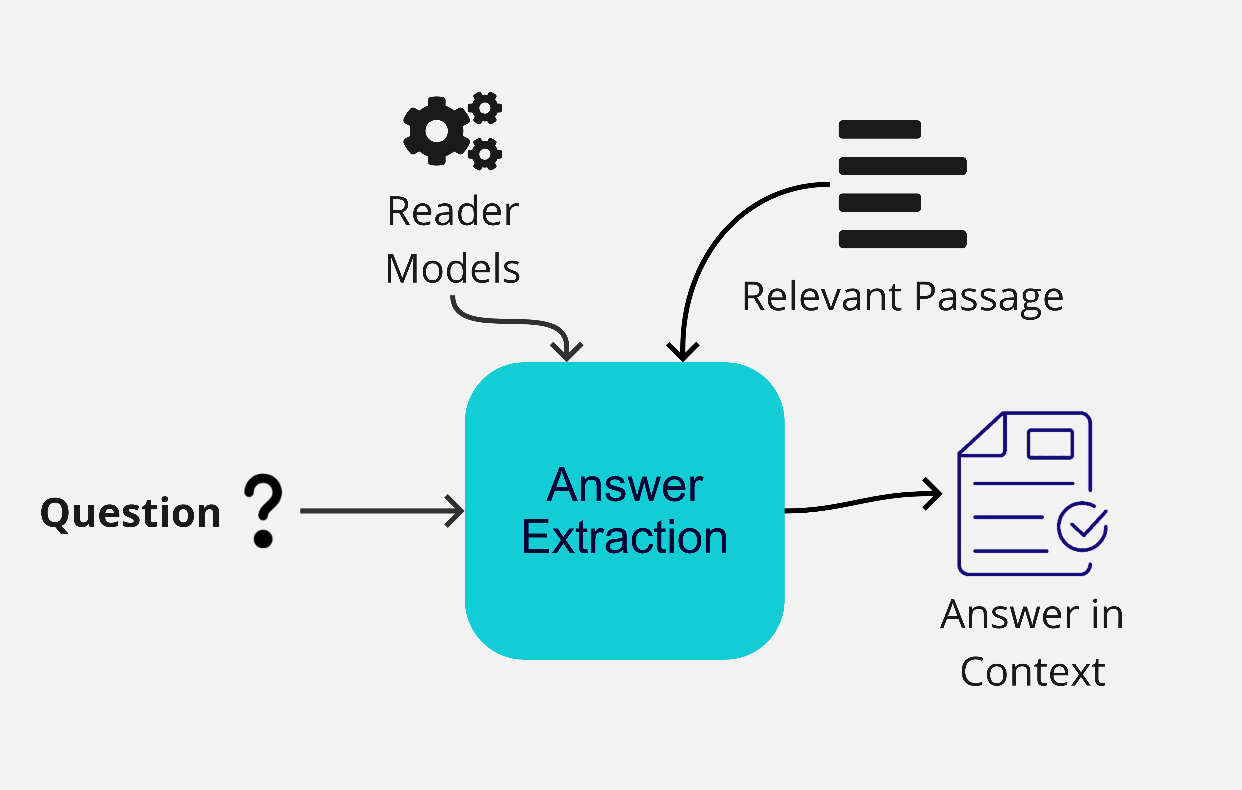
Answer Extraction (QA)

Slide 8
IR Options
Light options:
TF-IDF
BM25
Deep Learning based:
Dense Retrieval
Cross Encoder

Slide 9
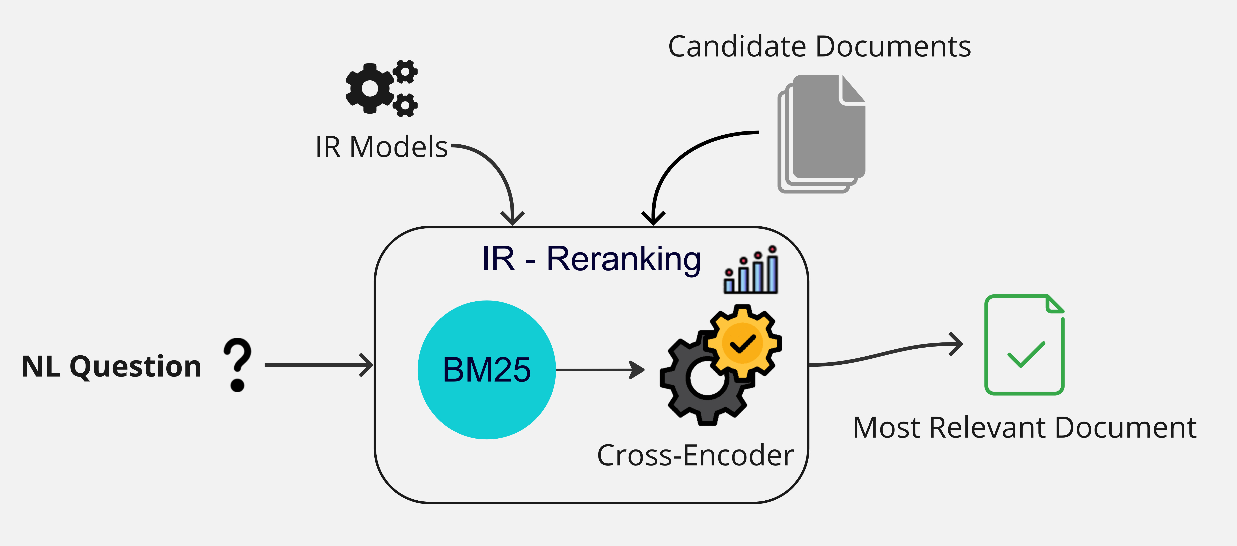
IR Reranking

Slide 10
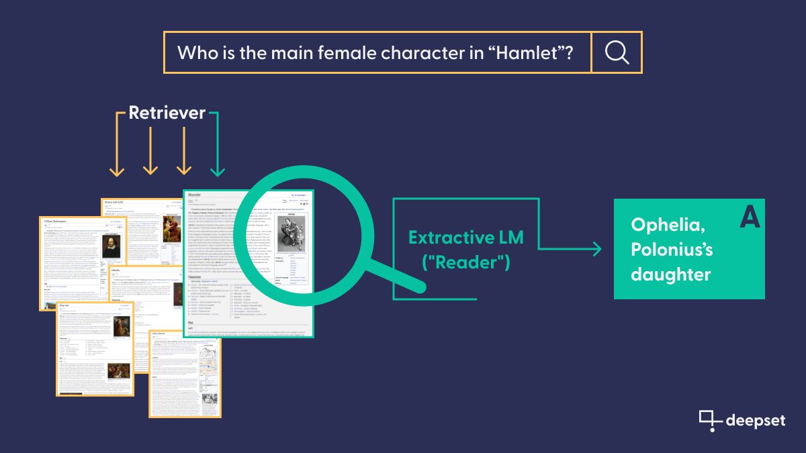
Example

Slide 11
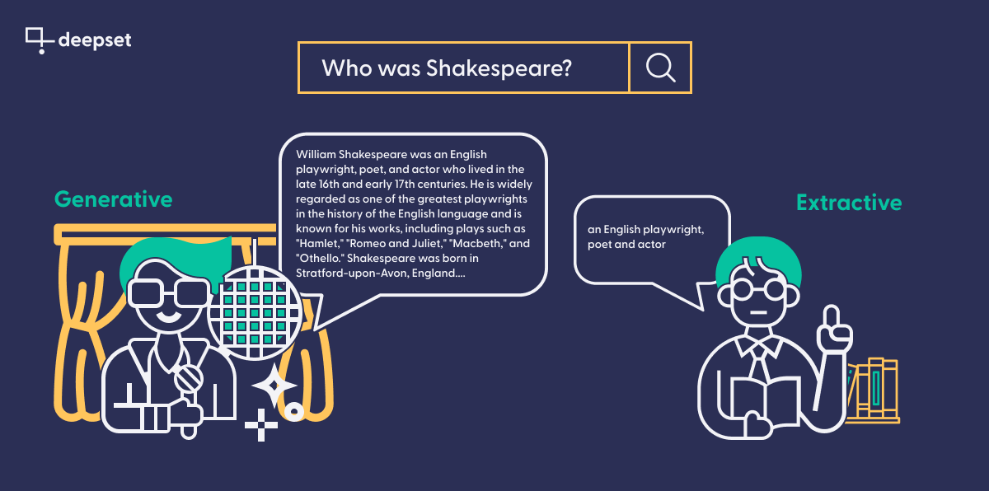
Generative vs Extractive QA

Slide 12
Tutorial
Google Colab environment (sign-in to your google account)
Haystack Library in Python
Build some pipelines
Use case: Healthcare
Chatbot

Slide 13
Use case Data
PubMedQA: biomedical question answering dataset collected from PubMed abstracts
Size: 272k instances
Contains: Question, Context, Answer

Slide 14
Advanced: Evaluation
Ground-Truth is needed: Questions and Answers
IR:
Context Recall
Context Precision
Context Relevancy
QA:
Semantic Similarity
Faithfulness

Slide 15
Question Answering & Information Retrieval
UCREL Summer School. Session 2:
Dr Saad Ezzini and Damith Dola Mullage

